Slide 1


PRESENTED BY: Hassan Zaib Jadoon
Large Language Models
From Scratch
Notes:
Note title
Type your notes here. They will be viewable in presenter view.

Slide 2

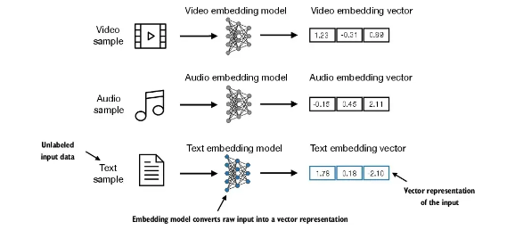
1. Data Preparation & Sampling
1.1.1 Word Embeddings: is an important term that is used for representing words for text analysis in the form of real-valued vectors. It is an advancement in NLP that has improved the ability of computers to understand text-based content in a better way. It is considered one of the most significant breakthroughs of deep learning for solving challenging natural language processing problems.
Word Embedding Types and Embedded Samples Examples
Notes:
Note title
Type your notes here. They will be viewable in presenter view.

Slide 3
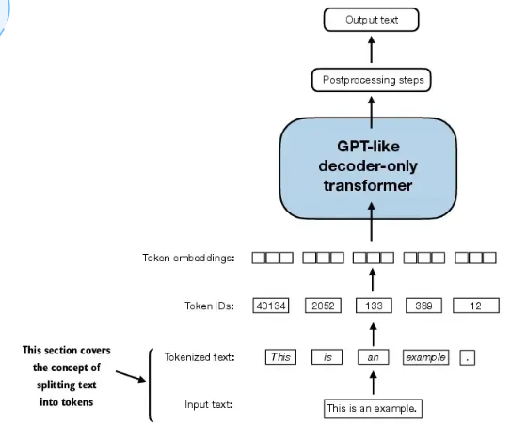
1. Data Preparation & Sampling
1.1.2 Tokenizing Text:
Convert text into small tokens like Hello Sir, this is Hassan into Tokenized form like Hello Sir, this is Hassan .
Tokenization is of two types; One is Word Tokenization and other is Sentence Tokenization.
Tokenization Helps in text processing like easier to use.
Tokenization serves as a basics for Extraction of features such as word frequencies, and syntactic structure which help in Sentiment analysis, entity recognition, and machine translation.
It also helps in syntax understanding. By breaking text into tokens, NLP models can better understand the context and meaning of words within the text.
Tokenizing Method
Notes:
Note title
Type your notes here. They will be viewable in presenter view.

Slide 4
1. Data Preparation & Sampling
1.1.3 Converting tokens into token IDs:
Token IDs are numerical representations assigned to each token in a vocabulary like assigning an id 13 to token Hassan.
Token IDs enable NLP models to process text data as numerical input, which is required for training.
Token to ID Mapping:
A vocabulary is a set of unique tokens extracted from the corpus.
Each token in the vocabulary is assigned a unique numerical ID.
OOV Tokens:
Out of Vocabulary Tokens
Strategies include replacing OOV tokens with a special token ID.
Special Tokens:
Special tokens like padding, unknown, and start/end of sequence tokens are often included in the vocabulary with specific token IDs.
Token Id’s allowing NLP models to process and analyze text efficiently. Secondly, they facilitate interoperability between different NLP systems and frameworks.
Notes:
Note title
Type your notes here. They will be viewable in presenter view.

Slide 5
1. Data Preparation & Sampling
1.1.4 Adding special context tokens:
Some of these special tokens are
[BOS] (beginning of sequence) marks the beginning of text
[EOS] (end of sequence) marks where the text ends (this is usually used to concatenate multiple unrelated texts, e.g., two different Wikipedia articles or two different books, and so on)
[PAD] (padding) if we train LLMs with a batch size greater than 1 (we may include multiple texts with different lengths; with the padding token we pad the shorter texts to the longest length so that all texts have an equal length)
[UNK] to represent works that are not included in the vocabulary.
Notes:
Note title
Type your notes here. They will be viewable in presenter view.

Slide 6
1. Data Preparation & Sampling
1.1.5 Byte pair Encoding:
Byte Pair Encoding (BPE) is a data compression technique used in natural language processing (NLP) for tokenization and vocabulary construction.
Pair Merging
BPE starts with a vocabulary of individual characters or tokens and iteratively merges the most frequent adjacent pairs.
Vocabulary Construction:
BPE iteratively merges character pairs until a predefined vocabulary size is reached.
It allows the model to break down words that aren't in its predefined vocabulary into smaller sub word units or even individual characters, enabling it to handle out-of-vocabulary words.
For instance, if GPT-2's vocabulary doesn't have the word "unfamiliarword," it might tokenize it as ["unfam", "iliar", "word"] or some other sub word breakdown, depending on its trained BPE merges.
Benefits of Byte Pair Encoding:
BPE can tokenize and represent OOV words as combinations of subword units present in the vocabulary.
BPE provides a fine-grained representation of words by breaking them down into subword units, capturing morphological and compositional information.
Notes:
Note title
Type your notes here. They will be viewable in presenter view.

Slide 7
1. Data Preparation & Sampling
1.1.6 Data sampling with a sliding window:
The sliding window technique is a data sampling method used in machine learning and signal processing to extract subsequences or segments from a larger dataset.
Sliding window sampling enables the creation of overlapping or non-overlapping segments for training, validation, or testing purposes.
LLM’s Training:
We train LLMs to generate one word at a time, so we want to prepare the training data accordingly where the next word in a sequence represents the target to predict. For each text chunk, we want the inputs and targets
Since we want the model to predict the next word, the targets are the inputs shifted by one position to the right.
Notes:
Note title
Type your notes here. They will be viewable in presenter view.

Slide 8
1. Data Preparation & Sampling
1.1.7 Creating token embeddings:
Token embeddings are dense vector representations of words or tokens in a continuous vector space, capturing semantic and syntactic similarities between tokens.
The data is already almost ready for an LLM.
But lastly let us embed the tokens in a continuous vector representation using an embedding layer
Usually, these embedding layers are part of the LLM itself and are updated (trained) during model training.
Advantages:
Token embeddings capture semantic similarities between words, enabling models to generalize across different contexts and tasks.
Pre-trained token embeddings can be transferred to downstream tasks, reducing the need for large annotated datasets and improving model performance.
Notes:
Note title
Type your notes here. They will be viewable in presenter view.

Slide 9
1. Data Preparation & Sampling
1.1.8 Encoding word positions:
Word position encoding is a technique used in NLP to represent the positions of words or tokens within a sequence, preserving their relative order.
Importance of Position Encoding:
In NLP tasks, such as machine translation or text generation, understanding the order of words is essential for capturing context and generating coherent output.
Position encoding helps disambiguate words with multiple meanings based on their positions within the sequence.
Benefits of Word Position Encoding:
Position encoding enables models to understand the sequential relationships between words, enhancing their ability to capture context and dependencies within the text.
Effective position encoding techniques facilitate model generalization to sequences of varying lengths and enable robust performance across different tasks and domains.
Notes:
Note title
Type your notes here. They will be viewable in presenter view.

Slide 10


THE END
THANK YOU!
DO YOU HAVE ANY QUESTIONS?
Notes:
Note title
Type your notes here. They will be viewable in presenter view.

